Slide 1
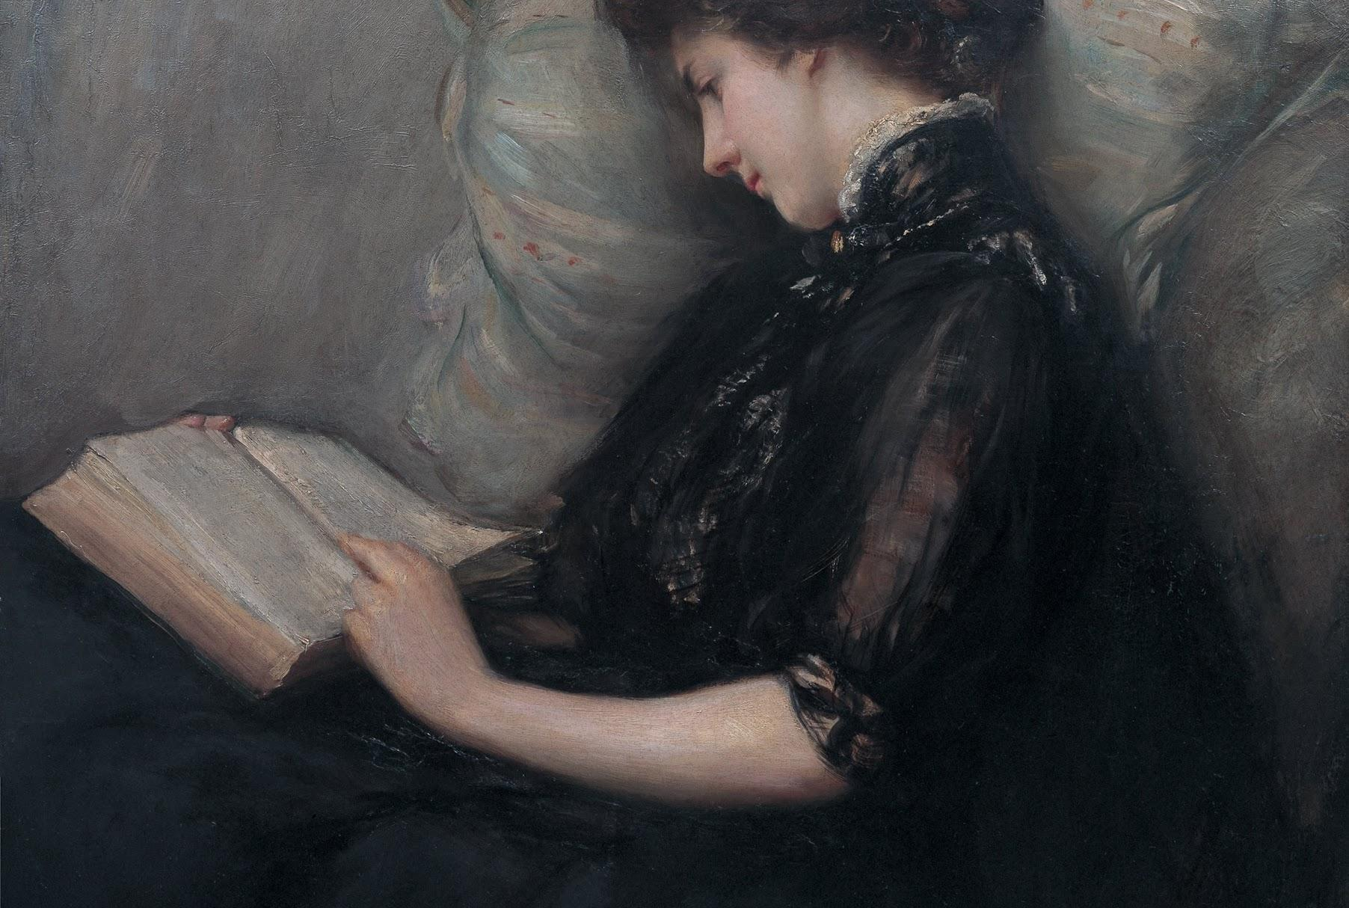
Carmina
Unlock The Rhythm Of Latin Poetry With Carmina
CSE 583 Final Project Presentation
December 2024

Slide 2
Contents
INTRODUCTIONS
1 TEAM
2 VISION
3 GOALS
PRODUCT ROADMAP
4 MILESTONES
5 TESTING
HIGHLIGHTS
6 SUPPORTS XML & PLAINTEXT FORMATS
7 METRICAL ANALYZES
8 COLLABORATION 1.0
APPENDIX
9 CHALLENGES
10 NEXT STEPS

Slide 3








Team
INTRODUCTIONS
HUI-HUSAN
CHAN
PhD Student
Department of Pharmacy
SIMON
NGUYEN
PhD Student
Department of Statistics
SUH YOUNG
CHOI
Masters Student
Department of Classics
ELIZABETH
NOVA
PhD Student
Department of Sociology

Slide 4

Our vision
INTRODUCTIONS
Carmina empowers classicists and digital humanities scholars to explore Latin poetry with ease, automating complex tasks like scansion, alliteration detection, and text matching.
By prioritizing simplicity and sustainability, Carmina bridges the gap between tradition and technology, making poetry analysis accessible to everyone.

Slide 5
Goals
INTRODUCTIONS
1
Employ a variety of literary analysis techniques like scansion, alliteration finding, and text matching to help a user analyze a segments of poetry.
2
Reading in XML and plaintext data; scanning dactylic hexameter; finding simple alliteration.

Slide 6
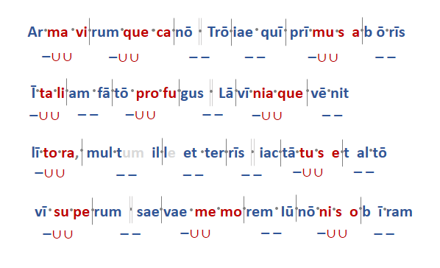
Latin Meter & Scansion
HIGHLIGHTS
Latin poetry follows a strict rhythm based on the quantity of the vowel in each syllable. Each line of poetry divides into a number of feet (analogous to the measures in music).
The syllables in each foot scan as “long” or “short” according to the parameters of the meter that the poet employs.
Notes:
Suh Young from here

Slide 7




Product Roadmap
PRODUCT ROADMAP
EXPLORING
DEVELOPING
TESTING
POETIC ANALYSIS
Reviewed Latin Poetry reading rules & scansion procedures with team.
PARSER
Broke down text/file into smaller parts.
TEST PARSER
TEST SCANSION
SCANSION
Marks metrical pattern of poem
USER STORIES
Determined the end users.
CASE STORIES
Broke down process.
DATA
XML and plaintext excerpts from the Aeneid
Notes:
Developing -> Parser: Reminder for audience, Parsing data in Python involves breaking down a given text or file into smaller parts that can be easily analyzed and manipulated.
Developing -> Scansion: Reminder for audience, Scansion marks the metrical pattern of a poem by breaking each line of verse up into feet and highlighting the accented and unaccented syllables.

Slide 8
Challenges
HIGHLIGHTS
Custom Solutions: Existing Python libraries didn’t fully meet our needs, requiring us to overcome challenges in building custom functions from scratch.
Time Constraints: Limited time prevented us from implementing all envisioned features, including function to export metrical analysis as standalone file and user experience (ux design).
Skill Diversity: Varied levels of Python experience within team made the project challenging for some, but collaboration & perseverance helped us succeed.

Slide 9
Next steps
1
Complete Envisioned Features
2
Enhance Accessibility
3
Submit to Conference
Notes:
Finalize key functionalities like the export function and improve the overall UX design.
Conduct thorough user testing to ensure Carmina is intuitive and accessible, even for users with minimal coding experience.
Present Carmina and its capabilities at [name] conference next year to share our work with the broader academic community. :]

Slide 10
Thank You!
Reach out to our Team:
Suh Young Choi: atobdura@uw.edu
Hui-Hsuan Chan: hhchan1@uw.edu
Simon Nguyen: simondn@uw.edu
Elizabeth Nova: emend026@uw.edu

